Slide 1
Professional Certificate Programme in Agentic AI and Applications

Slide 2
Working with Libraries

Slide 3
Revisit the Learning So Far
Let’s take a quick look at the key ideas and concepts you have explored in your learning journey.
An introduction to Python fundamentals, including variables, data types and numerical operations
Understanding Python data structures as essential building blocks for efficient programming
How lists store ordered collections and support flexible data manipulation
How tuples provide fixed, immutable sequences for secure data grouping
How sets enable fast membership checks and the removal of duplicate values
How dictionaries store key–value pairs for structured and accessible data handling
How Python conditional statements control the flow of logic based on different conditions

Slide 4
Revisit the Learning So Far
Let’s take a quick look at the key ideas and concepts you have explored in your learning journey.
How loops in Python automate repetitive tasks and streamline workflows
How to build a simple chatbot in Python using core programming techniques
A recap of essential Python concepts to reinforce understanding
How user-defined functions improve modularity, reuse and clarity in Python programmes
An applied example of integrating functions into a Python-based chatbot

Slide 5
Topics Covered
Error Handling in Python
Using Python Libraries​: Standard & Third-Party Modules in Action​
Importing Modules
Standard Libraries
Building CLI Calculator

Slide 6
Topics Covered
Project Structure
Working with NumPy and Pandas​
Python
Data Visualisation with Matplotlib and Seaborn​
Mastering Code Modularisation

Slide 7
Error Handling in Python
(Topic 1 of 10)

Slide 8

Error Handling in Python
Key Objectives
Understand errors and exceptions to write safer, more robust code
Apply practical strategies for effective error handling in Python
Notes:
Understanding errors and exceptions is essential for writing safer, more robust code. This presentation will guide you through practical strategies for effective error handling in Python.
Image:
https://image.shutterstock.com/image-photo/colorful-python-code-banner-260nw- 2286918497.jpg

Slide 9
Importance of Error Handling in Python
Program crashes abruptly, frustrating users and risking data loss | Program responds gracefully, provides feedback and continues running
Without Handling
With Handling
Notes:
Why Error Handling?
Programs often encounter unexpected situations:
Without Handling
Program crashes abruptly, frustrating users and potentially losing data
With Handling
Program responds gracefully, providing helpful feedback and continuing operation

Slide 10
Types of Errors
Syntax errors
Occur due to code structure mistakes and are caught before execution
Runtime errors (Exceptions)
Happen during execution when unexpected events occur and must be handled
Notes:
Types of Errors
Syntax Errors
Mistakes in code structure that prevent program from running
Python tells you immediately - these are caught before execution
print("Hello" # Missing closing parenthesis
Runtime Errors (Exceptions)
Errors that occur during execution when something unexpected happens
result = 10 / 0 # ZeroDivisionError
These need to be handled or they'll crash your program
Images: Slide Number :6

Slide 11
Common Exceptions in Python
ZeroDivisionError
IndexError
Occurs when dividing by zero: 10 / 0
List index out of range: my_list[99]
ValueError
KeyError
Invalid value: int("hello")
Dictionary key not found: my_dict["missing"]
TypeError
FileNotFoundError
Operation on incompatible types: "2" + 2
Missing file:("nonexistent.txt")
Notes:
Common Exceptions in Python
ZeroDivisionError
Occurs when dividing by zero: 10 / 0
ValueError
Invalid value: int("hello")
TypeError
Operation on incompatible types: "2" + 2
IndexError
List index out of range: my_list[99]
KeyError
Dictionary key not found: my_dict["missing"]
FileNotFoundError
Missing file: open("nonexistent.txt")
Image:
Remove the icons inside the infographics.
Repository Slide no: 44

Slide 12
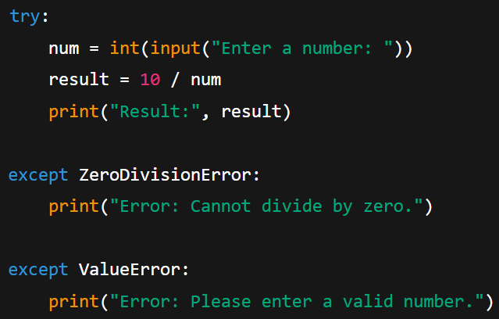
The try-except Block
try:
Contains the code that might cause an exception
except
Specifies what to do when specific errors occur
Notes:
The try-except Block try: num = int(input("Enter a number: ")) result = 10 / num print("Result:", result)except ZeroDivisionError: print("Error: Cannot divide by zero.")except ValueError: print("Error: Please enter a valid number.")
try:
Contains the code that might cause an exception
except:
Specifies what to do when specific errors occur
Image: Slide number 7 (Use Highlight effect for the coding and the OSTs.)

Slide 13
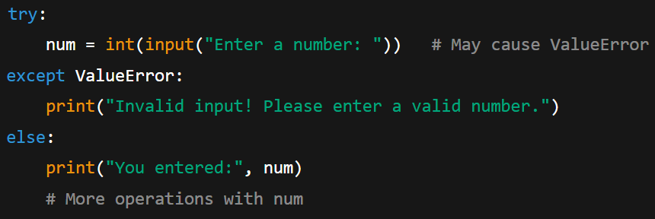
The else Clause
Purpose: Runs code only if the try block executes without exceptions
Benefit: Separates normal flow from error handling for clearer, more maintainable code
Notes:
The else Clause
try:num = int(input("Enter a number: ")) # May cause ValueErrorexcept ValueError:print("Invalid input! Please enter a valid number.")
else: print("You entered:", num # More operations with num
The else block runs only if the code in the try block executes without raising any exceptions.
This pattern separates normal code flow from error handling, making your code more readable and maintainable.
Image: Slide number: 8

Slide 14
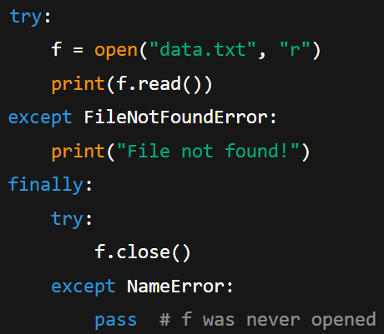
The finally Clause
Executes code regardless of whether an exception occurs
Notes:
The finally Clause
try:f = open("data.txt", "r") print(f.read())except FileNotFoundError:print("File not found!")finally:try:f.close()except NameError: pass # f was never opened
The finally block always executes whether an exception occurred or not.
Image: Slide number 9 (Use Highlight effect for the coding and the OSTs)

Slide 15



The finally Clause
Resource cleanup
Close files, database connections and network sockets
State reset
Resets application state or flags after operations
Logging
Logs whether an operation completed or failed
Notes:
Resource Cleanup
Close files, database connections, network sockets
State Reset
Reset application state or flags after operations
Logging
Record that an operation completed or failed
Image:
Repository Slide no: 28
Icon 1: https://www.shutterstock.com/image-vector/black-logout-exit-arrow-icon-sign- 1537022852
Icon 2: https://www.shutterstock.com/image-vector/reload-icon-vector-rotation-symbol- 1717918840
Icon 3: https://www.shutterstock.com/image-vector/log-file-vector-outline-icon-design- 2158394233

Slide 16
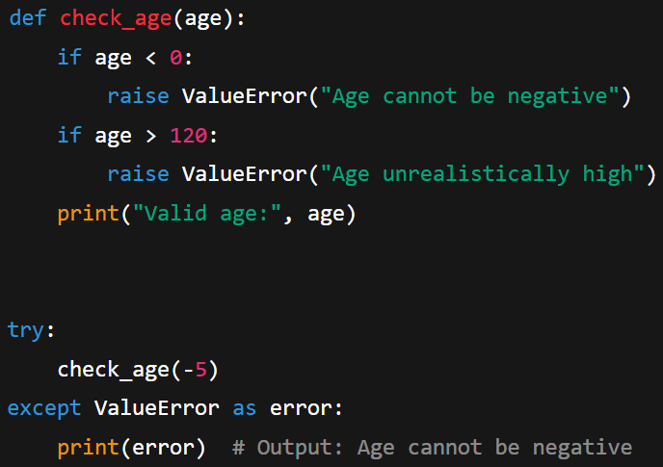
Raising Exceptions
Use raise to trigger custom exceptions when invalid conditions occur.
Notes:
Raising Exceptions
def check_age(age): if age < 0: raise ValueError("Age cannot be negative") if age > 120: raise ValueError("Age unrealistically high") print("Valid age:", age)try: check_age(-5)except ValueError as error: print(error) # Output: Age cannot be negative
Image: Slide number 10

Slide 17



Raising Exceptions
Use raise to
Enforce business rules
Validate input data
Signal impossible conditions
Notes:
Use raise to create your own exceptions when you detect invalid conditions in your code.
Raising exceptions allows you to:
Enforce business rules
Validate input data
Signal impossible conditions
Icon 1:https://enterprise.shutterstock.com/image-vector/set-outline-icons-related-policy-law- 2340013621
Icon 2:https://enterprise.shutterstock.com/image-vector/set-outline-icons-related-policy-law- 2340013621
Icon 3:https://enterprise.shutterstock.com/image-vector/set-outline-icons-related-policy-law- 2340013621
Repository Slide no: 28

Slide 18
Best Practices
Catch specific exceptions (ValueError, ZeroDivisionError), not just bare except: which can hide bugs
Keep try blocks small
Wrap only the lines that may raise exceptions, not large code blocks
Be specific
Provide helpful messages
Use finally or context managers (with statement) for cleanup
Give error messages that guide users to resolve issues
Clean up resources
Notes:
Best Practices
Be Specific
Catch specific exceptions (ValueError, ZeroDivisionError), not just bare except: which can hide bugs
Keep try Blocks Small
Only wrap the specific lines that might raise exceptions, not large blocks of code
Provide Helpful Messages
Error messages should guide users toward fixing the problem
Clean Up Resources
Always use finally or context managers (with statement) for cleanup
Repository Slide no: 31

Slide 19
Using Python Libraries
Standard & Third-Party Modules in Action
(Topic 2 of 10)

Slide 20




Python Libraries
Pre-Written Code for Ready-to-Use Functionality
Saves time
Use existing solutions instead of building from scratch
Reduces errors
Leverage thoroughly tested code from experts
Encourages reuse
Promote modular programming practices
Notes:
What Are Libraries?
A library is a collection of pre-written code that provides functionality you can use without rewriting it. Think of it as a toolbox with ready-made tools for specific tasks.
Saves Time
Use existing solutions instead of building from scratch
Reduces Errors
Leverages thoroughly tested code from experts
Encourages Reuse
Promotes modular programming practices
Image:
Repository Slide no: 44
Icon 1: https://www.shutterstock.com/image-vector/save-time-icon-hand-circle-clock- 1944489934
Icon 2: https://www.shutterstock.com/image-vector/error-icon-set-multiple-style-collection- 2665922035 icon 3: https://www.shutterstock.com/image-vector/two-arrow-spin-icon-recycle-round- 1905141526

Slide 21
Python Libraries
Common Examples
random
json
Generation of random numbers for simulations
Parsing and manipulating JSON data formats
math
requests
Mathematical operations and functions
Fetching and working with web data
Notes:
Common Examples:
math: Mathematical operations and functions
random: Generation of random numbers for simulations
requests: Fetching and working with web data
json: Parsing and manipulating JSON data formats
Image:
Remove the icons in the infographics
Repository Slide no: 68

Slide 22


Importance of Python Libraries
Extend functionality with Python’s vast collection of pre-written, tested libraries
Focus on solving problems instead of writing infrastructure code from scratch
Use existing solutions to avoid reinventing the wheel
Access a rich ecosystem
Save time
Improve productivity
Notes:
Why Libraries?
Rich Ecosystem
Python's power comes from its vast ecosystem of pre-written, tested code libraries that extend functionality.
Save Time
Don't "reinvent the wheel" — use existing solutions for common problems to accelerate development.
Improve Productivity
Focus on solving your specific problem rather than building infrastructure code from scratch.
Icons where taken from Side deck
Repository Slide no: 58
Icon 1: https://www.shutterstock.com/image-vector/internet-education-concept-elearning-resources-distant- 1485832811
Icon 2: https://www.shutterstock.com/image-vector/save-time-icon-hand-circle-clock- 1944489934
Icon 3: https://www.shutterstock.com/image-vector/enhanced-productivity-vector-icon-design- 2461585625

Slide 23
Two Types of Python Libraries
Included with Python by default | Require separate installation (commonly via pip)
Available for use without setup | Add functionality beyond Python’s core features
Standard libraries
Third-party libraries
Notes:
Two Types of Libraries
Standard Libraries
Built into Python installation
Ready to use without installation
Third-Party Libraries
Installed separately (usually via pip)
Extend Python beyond core functionality

Slide 24
Types of Python Libraries
Key Functionalities
Standard libraries (Built-in with Python, no setup required) | Third-party libraries (Community-created and installed via pip)
math: Advanced mathematical functions | requests: HTTP library for API calls
random: Pseudo-random number generators | numpy: Scientific computing
datetime: Date and time handling | pandas: Data analysis and manipulation
os: Operating system interfaces | matplotlib: Data visualisation
Notes:
Types of Python Libraries
Standard Libraries
Come built-in with Python installation - no additional setup required
math: Advanced mathematical functions
random: Pseudo-random number generators
datetime: Date and time handling
os: Operating system interfaces
Third-Party Libraries
Created by the Python community, installed using pip
requests: HTTP library for API calls
numpy: Scientific computing
pandas: Data analysis and manipulation
matplotlib: Data visualization

Slide 25
Importing Modules
(Topic 3 of 10)

Slide 26
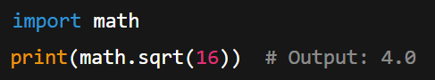
Importing Modules — Basics
Use import to bring in the whole module
Access functions with module_name.function()
Keep namespace clean and organised
Notes:
Importing Modules — Basics
The most common way to import a module is using the import statement:
import mathprint(math.sqrt(16)) # Output: 4.0
With this approach:
The entire module is imported
Functions are accessed using dot notation: module_name.function()
Namespace remains clean and organized
Image: Slide Number 16
Repository Slide no: 43 ( Remove icons from the infographas)

Slide 27
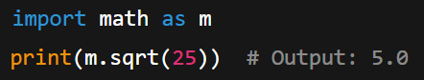
Importing with Aliases
Use Shorter Aliases
Import modules with as for concise code and clear namespace
Follow community naming conventions
Notes:
Importing with Aliases
import math as m
print(m.sqrt(25)) # Output: 5.0
Libraries can be imported with shorter aliases using the as keyword:
Makes code more concise
Maintains namespace organization
Follows community conventions
Repository Slide no: 91
Image: Slide number 17

Slide 28
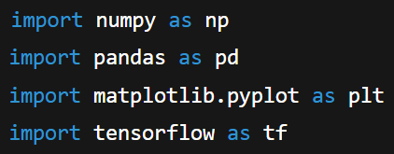
Importing with Aliases
Common Data Science Aliases
These aliases are widely recognised by experienced Python developers.
Notes:
Common Data Science Aliases
import numpy as npimport pandas as pdimport matplotlib.pyplot as pltimport tensorflow as tf
These aliases are so standard that experienced Python developers instantly recognize them.
Image: Slide number 17

Slide 29
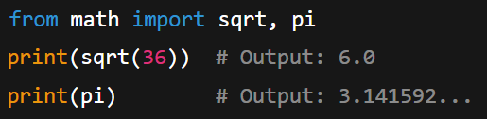
Importing Specific Functions
from Syntax
Import only needed items
Access functions without the module prefix
Keep code cleaner when using few functions
Notes:
Importing Specific Functions
from math import sqrt, piprint(sqrt(36)) # Output: 6.0print(pi) # Output: 3.141592...
The from syntax allows importing specific items:
Only imports what you explicitly need
Functions are directly accessible without the module prefix
Cleaner code when using just a few functions
Image: Slide number 18

Slide 30



Importing Specific Functions
When to Use This Approach
Import only a few specific functions
Ensure function names are distinctive to avoid conflicts
Improve readability by omitting the module prefix
Notes:
When to Use This Approach
This approach works best when:
You need only a few specific functions
Function names are distinctive enough to avoid conflicts
Code readability improves without the module prefix
Repository Slide no: 30
SSID
Icon 1:https://enterprise.shutterstock.com/image-vector/artificial-intelligence-line-editable-icons-set- 2292020353
Icon 2:https://enterprise.shutterstock.com/image-vector/artificial-intelligence-line-editable-icons-set- 2292020353
Icon 3:https://enterprise.shutterstock.com/image-vector/artificial-intelligence-line-editable-icons-set- 2292020353

Slide 31
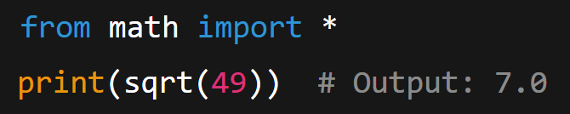
Import All (Not Recommended)
Use asterisk carefully: Imports all items from a module into the current namespace
Notes:
Import All (Not Recommended)
from math import *
print(sqrt(49)) # Output: 7.0
The asterisk * imports everything from a module into your current namespace.

Slide 32




Import All (Not Recommended)
Risks of Using * Imports
Triggers unexpected name conflicts
Obscures the origin of functions
Clutters the namespace with unused functions
Complicates debugging and maintenance
Best practice: Always specify what to import for maintainable code.
Notes:
Why This Is Problematic
Can cause unexpected name conflicts
Makes it unclear where functions come from
Clutters your namespace with unused functions
Makes code harder to debug and maintain
Best practice
Always be explicit about what you're importing to create more maintainable code.
Repository Slide no: 85
SSID:
Icon 1 :https://enterprise.shutterstock.com/image-vector/conflict-interest-business-concept-arrows-red- 747163177
Icon 2, 3 and 4: https://enterprise.shutterstock.com/image-vector/simple-set-data-analysis-related-vector- 602748734

Slide 33
Standard Libraries
(Topic 4 of 10)

Slide 34
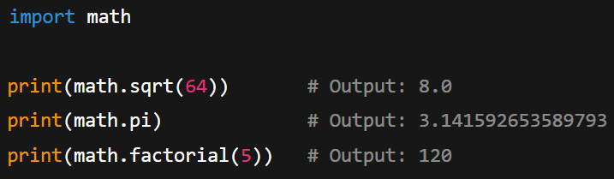
Standard Library — math
Providing standard C-based mathematical functions
Provides standard C-based mathematical functions
Notes:
Standard Library — math
import mathprint(math.sqrt(64)) # Output: 8.0print(math.pi) # Output: 3.141592653589793print(math.factorial(5)) # Output: 120
The math module provides access to mathematical functions defined by the C standard.
Image: Slide number 20

Slide 35
Standard Library — math
Common Functions
math.sqrt(x) - Square root
math.factorial(x) - Factorial
math.pi, math.e - Constants
math.pow(x, y)- Power function
math.ceil(x), math.floor(x) - Rounding
math.sin(x), math.cos(x)- Trigonometry
Notes:
Common Functions
math.sqrt(x) - Square root
math.pi, math.e - Constants
math.ceil(x), math.floor(x) - Rounding
math.factorial(x) - Factorial
math.pow(x, y) - Power function
math.sin(x), math.cos(x) - Trigonometry
Image: (Remove the icons from it.)
Infographic Repository Slide 44

Slide 36
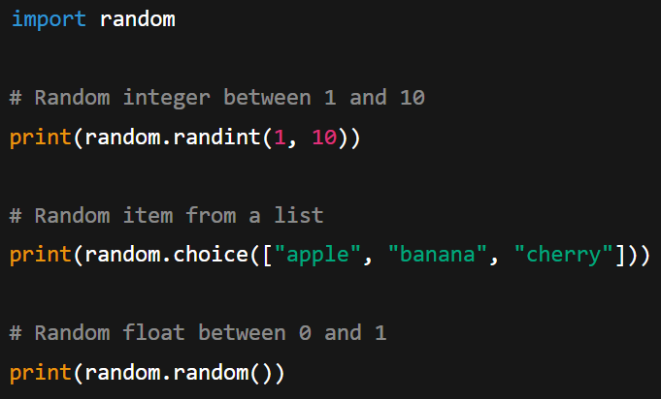
Standard Library — random
Implements pseudo-random number generators for multiple distributions
Notes:
Standard Library — random
import random# Random integer between 1 and 10print(random.randint(1, 10))# Random item from a listprint(random.choice(["apple", "banana", "cherry"]))
# Random float between 0 and 1print(random.random())
The random module implements pseudo-random number generators for various distributions.
Image: Slide number 21
Repository Slide no: 86

Slide 37




Standard Library — random
Use Cases
Used in games and simulations
Supports statistical sampling
Provides random testing data
Assists in algorithm testing
Notes:
Use Cases
Games and simulations
Statistical sampling
Random testing data
Algorithm testing
Image: Slide number 21
Repository Slide no: 86
Icon 1: https://www.shutterstock.com/image-vector/simulation-icon-trendy-flat-vector-on- 1210895371
Icon 2:https://www.shutterstock.com/image-vector/audit-icon-related-survey-line-style- 2344487249
Icon 3: https://www.shutterstock.com/image-vector/black-thin-line-tech-document-flow- 2154459289
Icon 4: https://www.shutterstock.com/image-vector/process-icons-automation-sign-mobile-concept- 2626945807

Slide 38
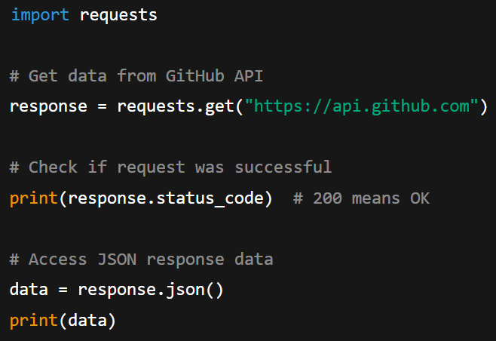
Third-Party Library — requests
Install first: pip install requests
The requests library simplifies making HTTP requests and handling responses.
Notes:
Third-Party Library — requests
Before using, install with: pip install requests
import requests# Get data from GitHub APIresponse = requests.get("https://api.github.com")# Check if request was successfuprint(response.status_code) # 200 means OK# Access JSON response datadata = response.json()print(data)
Image: Slide number 22

Slide 39





Third-Party Library — requests
Key Features
Provides an easy-to-use interface for HTTP methods (GET, POST, etc.)
Handles JSON parsing automatically
Maintains sessions and manages cookies
Supports authentication mechanisms
Enables file uploads and downloads
Notes:
Key Features
Simple API for HTTP methods (GET, POST, etc.)
Automatic JSON parsing
Session persistence and cookies
Authentication support
File uploads and downloads
Repository Slide no: 85 ( Remove numbers and place icons)
SSID:
Icon 1: https://enterprise.shutterstock.com/image-vector/comfort-functionality-convenient-use-vector-linear- 2388907647
Icon 2:https://enterprise.shutterstock.com/image-vector/simple-set-business-management-related-vector- 2148234533
Icon 3, 4 and 5:https://enterprise.shutterstock.com/image-vector/agile-icon-set-software-development-design- 2466608337

Slide 40
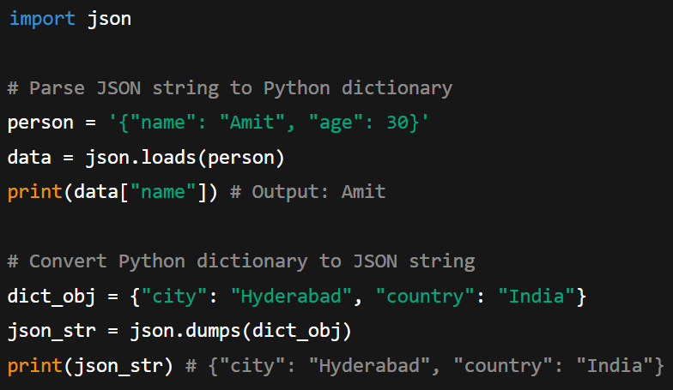
Third-Party Library — json
Notes:
Third-Party Library — json
import json# Parse JSON string to Python dictionaryperson = '{"name": "Amit", "age": 30}'data = json.loads(person)print(data["name"]) # Output: Amit
# Convert Python dictionary to JSON stringdict_obj = {"city": "Hyderabad", "country": "India"}json_str = json.dumps(dict_obj)print(json_str) # {"city": "Hyderabad", "country": "India"}
Image: Slide number 23

Slide 41
Third-Party Library — json
Key Functions
json.loads()- Parses JSON string to Python object
json.dumps()- Converts Python object to JSON string
json.load()- Reads JSON from a file
json.dump()- Writes Python object as JSON to a file
Notes:
Key functions:
json.loads() - Parses JSON string to Python object
json.dumps() - Converts Python object to JSON string
json.load() - Reads JSON from a file
json.dump() - Writes Python object as JSON to a file
Repository Slide no: 91

Slide 42
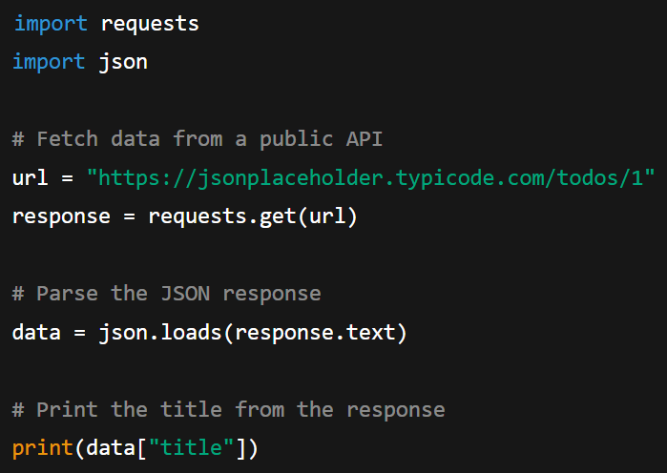
Combining Libraries
Example
Requests retrieves data, and JSON converts it into a Python dictionary
Notes:
Combining Libraries Example
import requestsimport json# Fetch data from a public APIurl = "https://jsonplaceholder.typicode.com/todos/1"response = requests.get(url)# Parse the JSON response
data = json.loads(response.text)# Print the title from the responseprint(data["title"])
This example shows how libraries work together: requests fetches the data, and json parses it into a usable Python dictionary.
Image: Slide number 24

Slide 43




Combining Libraries
Real World Applications
Develop API integrations
Create web applications
Construct data pipelines
Web scraping & automation
Notes:
Real-World Applications
Building data pipelines
Creating API integrations
Web scraping and automation
Building web applications
Image: (Remove the arrows from it.)
Repository Slide no: 68
Icon 1: https://www.shutterstock.com/image-vector/data-pipeline-icon-vector-logotype- 2438453863
Icon 2: https://www.shutterstock.com/image-vector/api-integration-icon-line-style- 2529168901
Icon 3: https://www.shutterstock.com/image-vector/web-scraping-icon-representing-data-extraction- 2592816305
Icon 4: https://www.shutterstock.com/image-vector/digital-tech-business-logo-template-gear- 2010883619

Slide 44
Best Practices
Import organisation
Group standard libraries first, third-party libraries next and local modules last
Separate groups with a blank line for readability
Import efficiency
Import only what you need
Use aliases for verbose module names
Avoid wildcard imports (from x import*)
Notes:
Best Practices
Import Organization
Group imports logically at the top of your file:
Standard libraries first
Third-party libraries next
Local modules last
Separate groups with a blank line for readability.
Import Efficiency
Import only what you need
Use aliases for verbose module names
Avoid wildcard imports (from x import *)
Image:
Remove the numbers and icons from the infographics
Repository Slide no: 86

Slide 45
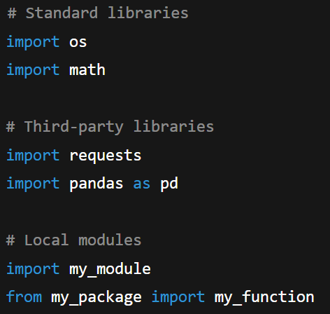
Best Practices
Code organisation: Structure imports consistently
Notes:
Code Organization
# Standard librariesimport osmport math# Third-party librariesimport requestsimport pandas as pd# Local modulesimport my_modulefrom my_package import my_function
Image: Slide number 25

Slide 46
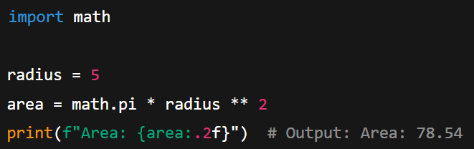
Examples
Calculate Circle Area
Uses the math module to calculate the area of a circle with mathematical precision.
Notes:
Examples
Calculate Circle Area
import mathradius = 5area = math.pi * radius ** 2print(f"Area: {area:.2f}") # Output: Area: 78.54
Uses the math module to calculate the area of a circle with mathematical precision.
Images: 26

Slide 47
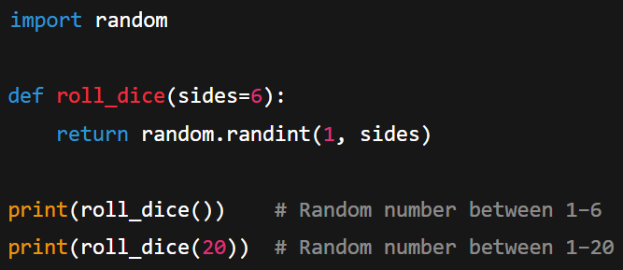
Examples
Simulate Dice Roll
Uses the random module to create a versatile dice-rolling function.
Notes:
Simulate Dice Roll
import randomdef roll_dice(sides=6): return random.randint(1, sides)print(roll_dice()) # Random number between 1–6print(roll_dice(20)) # Random number between 1–20
Uses the random module to create a versatile dice-rolling function.
Images: 26

Slide 48
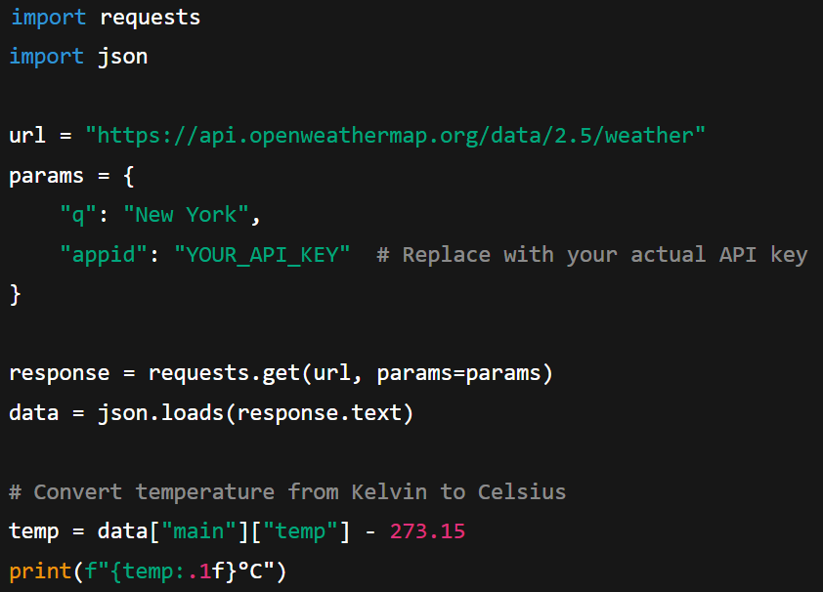
Examples
Fetch Weather Data
Combines requests and json to fetch real weather data.
Notes:
Fetch Weather Data
import requestsimport jsonurl = "https://api.openweathermap.org/data/2.5/weather"params = { "q": "New York", "appid": "YOUR_API_KEY" # Replace with your actual API key}
response = requests.get(url, params=params)data = json.loads(response.text)# Convert temperature from Kelvin to Celsiustemp = data["main"]["temp"] - 273.15print(f"{temp:.1f}°C")
Combines requests and json to fetch real weather data.
Images: 26

Slide 49
Building a CLI Calculator
(Topic 5 of 10)

Slide 50



Significance of CLI Calculator
Apply functions
Practice reusable logic through functions
Use modularisation
Organise code by separating it across multiple files
Handle user input/output
Manage interactions via the command-line interface
Notes:
Why a CLI Calculator?
Functions (reusable logic)
Practical way to apply reusable logic through functions
Modularization (separating code across files)
Learn how to organize code by separating it across multiple files
User input/output (command-line interface)
Practice handling user interactions through the command line
Image:
Repository Slide no: 86
Icon 1: https://www.shutterstock.com/image-vector/function-settings-icon-vector-set-editable- 1795100839
Icon 2: https://www.shutterstock.com/image-vector/display-code-icon-coding-tutorials-developer- 2481251967 icon 3: https://www.shutterstock.com/image-vector/command-line-interface-icon-vector-illustration- 2614857157

Slide 51


Significance of CLI Calculator
Encourage clean project structure
Develop good coding habits for code organisation
Mimic real-world practices
Experience how professional software is structured
Notes:
Encourages clean project structure
Develop good habits for organizing your code
Mimics real-world coding practices
Experience how professional software is structured
Image:
Repository Slide no: 85
Icon 1: https://www.shutterstock.com/image-vector/project-infrastructure-linear-icon-concept-line- 1092311309
Icon 2: https://www.shutterstock.com/image-vector/laptop-gears-icon-update-screen-process- 1927920251

Slide 52

CLI – Command Line Interface
Runs programs directly in the terminal or console
Interacts using text only, without a GUI
Notes:
CLI – Command Line Interface
A program that runs in the terminal/console
Interaction via text (no GUI)
Image:
Repository Slide no:
https://image.shutterstock.com/image-photo/programming-language-concept-system-engineering-260nw-1404621860.jpg

Slide 53




CLI – Command Line Interface
Key Steps Involved
Show menu/options
Accept user input
Perform operation
Show result
Notes:
Typical steps:
01
Show menu/options
02
Accept user input
03
Perform operation
04
Show result
Image:
Repository Slide no: 141
Icon 1: https://www.shutterstock.com/image-vector/variety-choice-icon-selection-variation-concept- 1963144069
Icon 2: https://www.shutterstock.com/image-vector/text-field-input-cursor-button-icon- 1976622635 Icon 3: https://www.shutterstock.com/image-vector/process-management-icon-optimization-operation-fix- 1608241963
Icon 4: https://www.shutterstock.com/image-vector/outcome-vector-outline-icon-design-illustration- 2185436573

Slide 54
Project Structure
(Topic 6 of 10)

Slide 55
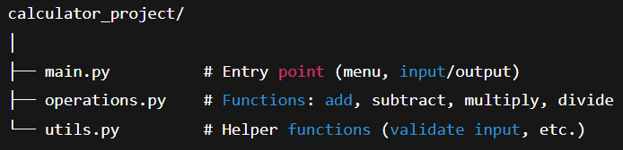
Project Structure
Notes:
Project Structure
calculator_project/
│
├── main.py # Entry point (menu, input/output)
├── operations.py # Functions: add, subtract, multiply, divide
└── utils.py # Helper functions (validate input, etc.)
Image:
Use highlighting effect for the coding.
Slide 30

Slide 56
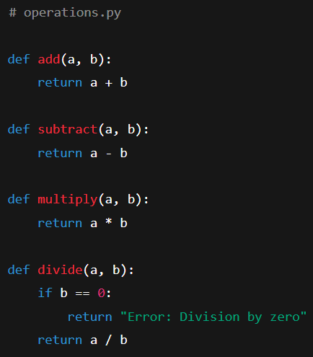
operations.py (Functions)
Each function performs a specific operation and returns the result.
Notes:
operations.py (Functions)
# operations.py
def add(a, b):
return a + b
def subtract(a, b):
return a - b
def multiply(a, b):
return a * b
def divide(a, b):
if b == 0:
return "Error: Division by zero
Each function performs a specific mathematical operation and returns the result.
Image:
Slide 31

Slide 57
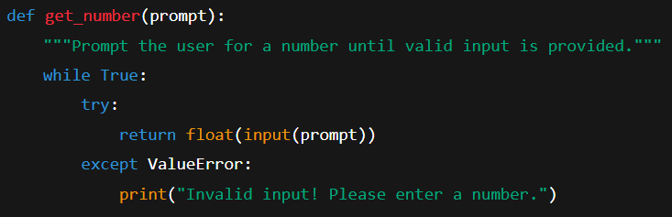
utils.py (Helper Functions)
Prompt the user: Display a message requesting numeric input.
Validate the input: Convert input to float using try-except.
Return or retry: Return valid number or show error and repeat.
Notes:
utils.py (Helper Functions)
# utils.py
def get_number(prompt):
"""Prompt the user for a number until valid input is provided."""
while True:
try:
return float(input(prompt))
except ValueError:
print("Invalid input! Please enter a number.")
Prompt User
Display message asking for input
Validate Input
Try to convert to float
Return or Retry
Return valid number or show error
Image:
Slide 32

Slide 58
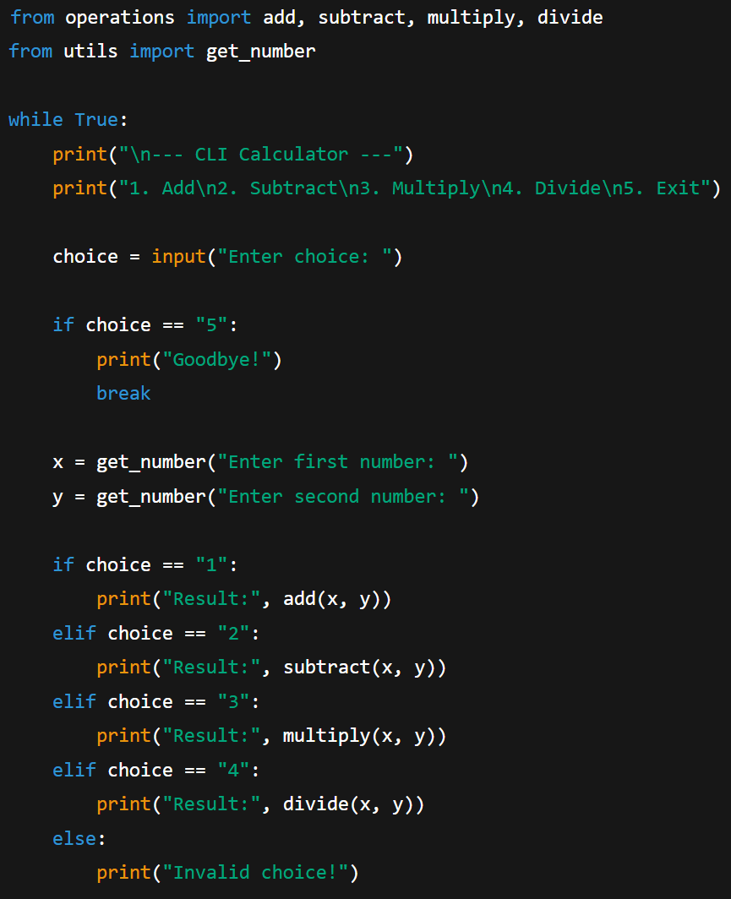
main.py (CLI Entry Point)
Notes:
main.py (CLI Entry Point)
from operations import add, subtract, multiply, divide
from utils import get_number
while True:
print("\n--- CLI Calculator ---")
print("1. Add\n2. Subtract\n3. Multiply\n4. Divide\n5. Exit")
choice = input("Enter choice: ")
if choice == "5":
print("Goodbye!")
break
x = get_number("Enter first number: ")
y = get_number("Enter second number: ")
if choice == "1":
print("Result:", add(x, y))
elif choice == "2":
print("Result:", subtract(x, y))
elif choice == "3":
print("Result:", multiply(x, y))
elif choice == "4":
print("Result:", divide(x, y))
else:
print("Invalid choice!")
Image:
Slide 33

Slide 59
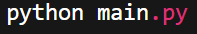
Running the Calculator
Command in terminal:
Sample Run:
--- CLI Calculator ---​
1. Add​
2. Subtract​
3. Multiply​
4. Divide​
5. Exit​
​
Enter choice: 1​
Enter first number: 10​
Enter second number: 5​
Result: 15​
Notes:
Running the Calculator
Command in terminal:
python main.py
Sample Run:
--- CLI Calculator ---
1. Add
2. Subtract
3. Multiply
4. Divide
5. Exit
Enter choice: 1
Enter first number: 10
Enter second number: 5
Result: 15
Image:
Slide 34

Slide 60




Key Takeaways
Enable code reuse
Practice real-world projects
Write functions once and use them multiple times
Develop CLI applications to build skills for larger systems
Improve organisation
Support scalability
Split code across files for easier maintenance and clarity
Add new functions without modifying the core project structure
Notes:
Key Takeaways
Functions make code reusable
Write once, use many times
CLI applications → great practice for real-world projects
Fundamental skills that apply to larger systems
Splitting across files improves organization
Easier to maintain and understand
Structure scales: you can add new operations easily
Just add new functions without changing the core structure
Image:
Infographic Repository Slide 31
Icon 1: https://www.shutterstock.com/image-vector/code-icon-trendy-flat-style-isolated- 421269664
Icon 2: https://www.shutterstock.com/image-vector/command-window-icon-editable-stroke- 2578591511
Image 3: https://www.shutterstock.com/image-vector/module-icon-collection-multiple-styles- 2633540031 (First icon)
Icon 4: https://www.shutterstock.com/image-vector/scalability-scalable-system-line-art-vector- 1752041657

Slide 61
Hands-on Call a public API
Refer to exercise document.
Notes:
Hands-on Call a public API
Image: Slide number 36

Slide 62
Working with NumPy and Pandas
A practical introduction to efficient data analysis using Python's powerful numerical libraries
(Topic 7 of 10)
Notes:
A practical introduction to efficient data analysis using Python's powerful numerical libraries

Slide 63
Numpay & Pandas
Lists and dictionaries are flexible but inefficient for large data analysis
Performs fast array operations | Built on NumPy for efficiency
Serves as the foundation for scientific computing | Handle tabular data easily
Benefits from optimised C implementation | Offer Excel-like functionality with programmability
NumPy
Pandas
Notes:
Why NumPy & Pandas?
Python's built-in data structures (lists, dictionaries) are flexible but not efficient for serious data analysis
NumPy
Fast array operations
Foundation for scientific computing
Optimized C implementation
Pandas
Built on NumPy
Makes tabular data easy to handle
Similar to Excel, but programmable

Slide 64
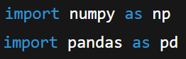
Importing Libraries
Use standard aliases: np for NumPy and pd for Pandas are universally recognised
Place Imports correctly: Place imports at the top of the file
Notes:
Importing Libraries
import numpy as npimport pandas as pd
Standard Aliases
np and pd are universally recognized shortcuts
Import Location
Always place imports at the top of your file before any other code
Repository Slide no: 43
Image: Silde number 39

Slide 65
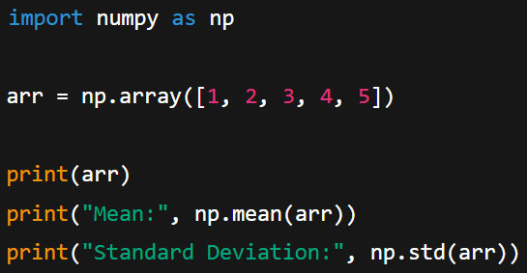
NumPy Basics
Performance: 10–100x faster than Python lists for mathematical operations
Functionality: 50+ built-in mathematical and statistical functions
Notes:
NumPy Basics
import numpy as nparr = np.array([1, 2, 3, 4, 5])print(arr)print("Mean:", np.mean(arr))print("Standard Deviation:", np.std(arr))
10-100xFaste Than Python lists for mathematical operations
. 50+Functions Built-in mathematical and statistical operations
Image: Slide number 40

Slide 66
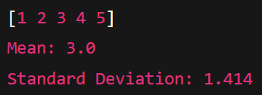
NumPy Basics
Example Outputs
Notes:
Example outputs:
[1 2 3 4 5]Mean: 3.0Standard Deviation: 1.414
Image: Slide number 40

Slide 67
Python
(Topic 8 of 10)

Slide 68



Pandas Dominating Data Science
Key Reasons
Efficient processing
Seamless integration
Flexible & expressive
Work smoothly with NumPy, Matplotlib, and Scikit-Learn
Use intuitive syntax for clear and simple data manipulation
Handle large structured datasets quickly
Notes:
Why Pandas Dominates Data Science
Efficient Processing
Handles structured data with lightning speed, optimized for large datasets and complex operations.
Seamless Integration
Works perfectly with NumPy, Matplotlib, and Scikit-Learn for complete data science workflows.
Flexible & Expressive
Intuitive syntax makes complex data manipulation tasks simple and readable.
Image:
Infographic Repository Slide 14
Icon 1: https://www.shutterstock.com/image-vector/data-processing-vector-icon- 624577427
Icon 2: https://www.shutterstock.com/image-vector/infinite-loop-linear-icon-ongoing-process- 2520713301
Icon 3: https://www.shutterstock.com/image-vector/syntax-icon-outline-style-vector-illustration- 2615297943

Slide 69
Essential Data Analysis Functions
Use .head(), .tail(), .info()and .shape to examine structure and quality
Organise with .sort_values()and filter using .query()or conditions
Data inspection
Sorting & filtering
Access data with .loc[], .iloc[] and boolean indexing for precise analysis
Remove duplicates with .drop_duplicates()to ensure data integrity
Smart selection
Data quality
Notes:
Essential Data Analysis Functions
Data Inspection
Explore your data with .head(), .tail(), .info(), and .shape to understand structure and quality.
Sorting & Filtering
Organize data with .sort_values() and filter using conditions or the powerful .query() method.
Smart Selection
Access data precisely using .loc[], .iloc[], and boolean indexing for targeted analysis.
Data Quality
Clean datasets by removing duplicates with .drop_duplicates() and maintaining data integrity.
Image:
Infographic Repository Slide 31

Slide 70
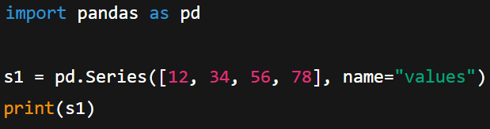
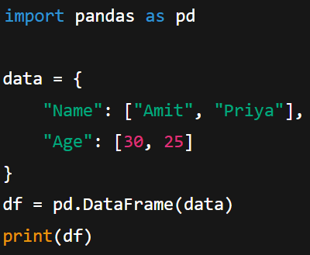
Pandas Data Structures
Series
Represents a one-dimensional labelled array
Stores values with an index for easy access
DataFrame
Represents a two-dimensional labelled table
Combines multiple Series objects with shared index
Notes:
Pandas Data Structures
1. Series
1D labeled array (like a single column)
Contains values with an index
import pandas as pd
S1 = pd.Series([12,34,56,78])
2. DataFrame
2D labeled table (like an Excel sheet)
Collection of Series objects sharing an index
import pandas as pd
data = {
"Name": ["Amit", "Priya"],
"Age": [30, 25]
}
df = pd.DataFrame(data)
print(df)

Slide 71
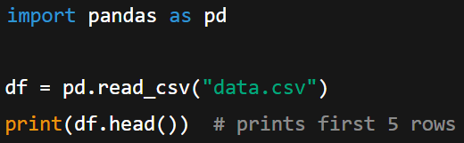
Loading CSV with Pandas
pd.read_csv() → loads CSV files into DataFrame
df.head() → quick preview of data (first 5 rows)
df.head(10) → view first 10 rows
Notes:
Loading CSV with Pandas
import pandas as pd
df = pd.read_csv("data.csv")
print(df.head()) # First 5 rows
pd.read_csv() → loads CSV files into DataFrame
df.head() → quick preview of data (first 5 rows)
df.head(10) → view first 10 rows

Slide 72
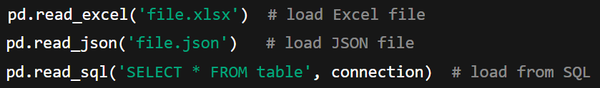
Loading CSV with Pandas
Pandas also supports Excel, JSON, SQL and other formats via similar functions
Notes:
Pandas can also read Excel, JSON, SQL, and many other formats with similar functions:
pd.read_excel()
pd.read_json()
pd.read_sql()

Slide 73
Selecting Data
Single column
Use print(df['Name'])to return a Series object
Multiple columns
Use print(df[['Name','Age']]) (note the double brackets) to return a DataFrame
Row by position
Use print(df.iloc[0])for integer location-based indexing
Specific cell
Use print(df.loc[0, 'Name'])for label-based indexing
Notes:
Selecting Data
Single Column
print(df['Name'])
Returns a Series object
Multiple Columns
print(df[['Name','Age']])
Note the double brackets
Returns a DataFrame
Row by Position
print(df.iloc[0])
Integer location-based indexing
Specific Cell
print(df.loc[0, 'Name'])
Label-based indexing
Image:
Repository Slide 91

Slide 74



Inspecting Data
Size
Use print(df.shape) to return (rows, columns)
Example: (891, 12)
Column names
Use print(df.columns) to show all column headers
Example: Index(['Name', 'Age', ...])
Metadata
Use print(df.info()) to view data types, non-null values and memory usage
Notes:
Inspecting Data
Size
print(df.shape)
Returns (rows, columns)
Example: (891, 12)
Column Names
print(df.columns)
Shows all column headers
Example: Index(['Name', 'Age'...])
Metadata
print(df.info())
Data types, non-null values, memory usage
Image:
Infographic Repository Slide 86
Icon 1: https://www.shutterstock.com/image-vector/file-size-icon-4-different-styles- 2510984831 (First icon)
Icon 2: https://www.shutterstock.com/image-vector/report-statistics-line-icon-column-graph-
Icon 3: https://www.shutterstock.com/image-vector/metadata-icon-isolated-on-white-background- 2282457901

Slide 75




Data Summarisation Powerhouse
Descriptive statistics
Central tendencies
Use .describe() to quickly obtain count, mean, standard deviation, quartiles and more
Calculate .mean(), .median() and .mode() to understand data centre
Frequency analysis
Dispersion metrics
Count unique values and frequencies with .value_counts()and .nunique() for categorical data
Use .std(), .var(), .min() and .max() to assess data spread
Notes:
Data Summarization Powerhouse
Descriptive Statistics
Get comprehensive insights instantly with .describe() - count, mean, std, quartiles, and more in one command.
Central Tendencies
Measure data center with .mean(), .median(), and .mode() for robust analysis.
Dispersion Metrics
Understand data spread using .std(), .var(), .min(), and .max() functions.
Frequency Analysis
Count unique values and frequencies with .value_counts() and .nunique() for categorical insights.
Image:
Infographic Repository Slide 31
Icon 1: https://www.shutterstock.com/image-vector/descriptive-linear-icon-showing-summarize-characteristics- 1891804567
Icon 2: https://www.shutterstock.com/image-vector/editable-line-style-icon-depicting-central- 2451304973 Icon 3: https://www.shutterstock.com/image-vector/spreading-online-document-shares-receives-important- 2409387691
Icon 4: https://www.shutterstock.com/image-vector/detection-extraneous-noise-icon-line-design- 2542612337

Slide 76




Grouping and Aggregation
Split-Apply-Combine: Core Paradigm for Grouped Data Analysis
Group data
Apply functions
Multiple aggregations
Pivot tables
Use .groupby() to segment data based on categorical variables
Perform aggregations (sum, mean, count) on each group
Apply multiple operations at once using .agg() for detailed analysis
Create cross-tabulations and summary tables using .pivot_table() for Excel-like functionality
Notes:
Grouping and Aggregation
Split-Apply-Combine
The fundamental paradigm for grouped data analysis
Group Data
Use .groupby() to split data into meaningful segments based on categorical variables.
Apply Functions
Perform aggregations like sum, mean, count, or custom functions on each group.
Multiple Aggregations
Execute several operations simultaneously with .agg() for comprehensive analysis.
Pivot Tables
Create cross-tabulations and summary tables using .pivot_table() for Excel-like functionality.
Image: (Remove the arrows from it.)
Infographic Repository Slide 84
Icon 1: https://www.shutterstock.com/image-vector/organization-chart-icon-vector- 795280720
Icon 2: https://www.shutterstock.com/image-vector/data-aggregation-icon-trendy-modern-flat- 1221886945
Icon 3: https://www.shutterstock.com/image-vector/data-aggregation-icon-simple-element-illustration- 1557302993
Icon 4: https://www.shutterstock.com/image-vector/document-spreadsheet-line-icon-file-pivot- 1517885066

Slide 77




Mastering Missing Data
Strategic imputation
Detect missing values
Use .fillna() to fill missing values with strategies like mean, median or custom values
Use .isnull() and .notnull() to identify gaps in data
Smart removal
Advanced interpolation
Remove incomplete records with .dropna() by specifying rows or columns
Estimate missing values using .interpolate() for time-series and numerical data
Notes:
Mastering Missing Data
Detect Missing Values
Identify gaps in your data using .isnull() and .notnull() for comprehensive data quality assessment.
Strategic Imputation
Fill missing values intelligently with .fillna() using means, medians, or custom strategies.
Smart Removal
Remove incomplete records selectively with .dropna() parameters for rows or columns.
Advanced Interpolation
Estimate missing values using .interpolate() for time-series and numerical data patterns.
Image:
Infographic Repository Slide 80

Slide 78



Data Transformation Techniques
Function application
Use .apply(), .map() and .applymap() to perform custom calculations and clean data
Data binning
Group continuous data into categories with pd.cut()or pd.qcut()for analysis and modeling
Vectorised operations
Apply element-wise operations efficiently using pandas’ optimised computation, avoiding explicit loops
Categorical encoding
Convert categorical variables into numeric formats for machine learning and statistical tasks
Notes:
Data Transformation Techniques
Function Application
Transform data with .apply(), .map(), and .applymap() for custom calculations and data cleaning operations.
Data Binning
Create categorical groups from continuous data using pd.cut() and pd.qcut() for analysis and modeling.
Vectorized Operations
Perform element-wise operations efficiently without loops, leveraging pandas' optimized computational engine.
Categorical Encoding
Convert categorical variables into numerical formats for machine learning algorithms and statistical analysis.
Image:
Infographic Repository Slide 18
Icon 1: https://www.shutterstock.com/image-vector/financial-calculation-line-icon- 1266623245
Icon 2: https://www.shutterstock.com/image-vector/organization-chart-icon-vector- 795280720
Icon 3: https://www.shutterstock.com/image-vector/useful-functions-vector-line-icon- 597406976
Icon 4: https://www.shutterstock.com/image-vector/computer-binary-code-software-icons-digital- 2443566949

Slide 79

Real-World Example
Customer Analytics
Data inspection
Use .info() to check missing values, data types and memory usage
Behavioural analysis
Analyse spending patterns with .groupby('gender').mean()
Notes:
Real-World Example: Customer Analytics
Data Inspection
Start with .info() to identify missing values, data types, and memory usage across customer records.
Behavioral Analysis
Analyze purchase patterns by gender using .groupby('gender').mean() to uncover spending differences.
Image:
https://www.shutterstock.com/image-photo/analyst-working-on-business-analytics-dashboard-2201354105

Slide 80
Real-World Example: Customer Analytics
Customer Analytics
Geographic Insights
Count unique customer locations with .nunique()
Outlier detection
Identify unusual purchases using .describe()
Notes:
Real-World Example: Customer Analytics
Geographic Insights
Count unique customer locations with .nunique() to understand market penetration and reach.
Outlier Detection
Use .describe() to identify unusual purchase amounts and customer behavior patterns requiring investigation.
Image:
https://www.shutterstock.com/image-photo/analyst-working-on-business-analytics-dashboard-2201354105

Slide 81

Visualisation Integration
Built-in Plotting Power
Uses .plot()for rapid exploratory data analysis including:
Line plots for trends​
Bar charts for comparisons​
Histograms for distributions​
Scatter plots for relationships​
Integrates with Matplotlib and Seaborn for publication-quality visualisations
Notes:
Visualization Integration
Built-in Plotting Power
Pandas includes integrated plotting capabilities with .plot() for rapid exploratory data analysis.
Line plots for trends
Bar charts for comparisons
Histograms for distributions
Scatter plots for relationships
Seamlessly integrates with Matplotlib and Seaborn for publication-quality visualizations.
Image:
https://image.shutterstock.com/z/stock-photo-daw-music-production-equalizer-audio-samples-scores-computer-music- 1822049927.jpg

Slide 82
Key Takeaways
Equip data scientists with tools for all stages of the workflow
Efficient exploratory analysis
Use summarisation functions to accelerate insights discovery
Comprehensive toolkit
Apply grouping, aggregation and transformation for deeper analytical insights
Build a base for advanced analytics, machine learning and data science tasks
Powerful data transformation
Powerful data transformation
Notes:
Key Takeaways
Comprehensive Toolkit
Pandas provides robust data analysis tools for every stage of the data science pipeline.
EDA Efficiency
Summarisation functions streamline exploratory data analysis and accelerate insights discovery.
Powerful Transformation
Grouping, aggregation, and transformation capabilities unlock deep analytical insights from raw data.
ML Foundation
Essential foundation for advanced analytics, machine learning, and data science workflows.
Image:
Infographic Repository Slide 31

Slide 83
Hands-on: Numpy
Refer to exercise document.
Notes:
Hands-on: Numpy
Refer to exercise document.

Slide 84
Hands-on: Pandas
Refer to exercise document.
Notes:
Hands-on: Numpy
Refer to exercise document.

Slide 85
Data Visualisation with Matplotlib and Seaborn
Turning data into insights through powerful Python visualisation libraries
(Topic 9 of 10)

Slide 86

Data Visualisation with Matplotlib and Seaborn
Create visual stories
Transform raw numbers into visuals that drive understanding and action
Enable exploratory analysis
Use tools for pattern discovery and hypothesis generation
Notes:
Data Visualization with Matplotlib and Seaborn
Turning Data into Insights
Transform raw numbers into meaningful visual stories that drive understanding and action.
Foundation for EDA
Essential tools for exploratory data analysis, enabling pattern discovery and hypothesis generation.
Image:
https://image.shutterstock.com/image-photo/business-intelligence-concept-data-analysis-260nw-2288262579.jpg

Slide 87




Importance of Data Visualisation
Clarify data
Communicate insights
Convert complex datasets into easily interpretable visuals
Present findings clearly to stakeholders for better understanding
Discover patterns
Inform decisions
Identify trends, outliers and hidden relationships in the data
Provide actionable insights to guide data-driven choices
Notes:
Why Visualization Matters
Makes Complex Data Understandable
Visual representations help the human brain process information faster than raw numbers.
Communicates Effectively
Share insights with stakeholders through clear, compelling visual narratives.
Reveals Hidden Patterns
Uncover trends, outliers, and relationships that aren't obvious in tabular data.
Supports Better Decisions
Enable data-driven decision making through accessible, actionable insights.
Image:
Infographic Repository Slide 81
Icon 1: https://www.shutterstock.com/image-vector/clarifying-system-goals-vector-illustration-icon- 2456418783 icon 2: https://www.shutterstock.com/image-vector/audit-data-analysis-icon-like-thin- 2481699581
Icon 3: https://www.shutterstock.com/image-vector/financial-analysis-that-uses-patterns-market- 2338172073
Icon 4: https://www.shutterstock.com/image-vector/data-driven-icon-line-vector-illustration- 2646674283

Slide 88
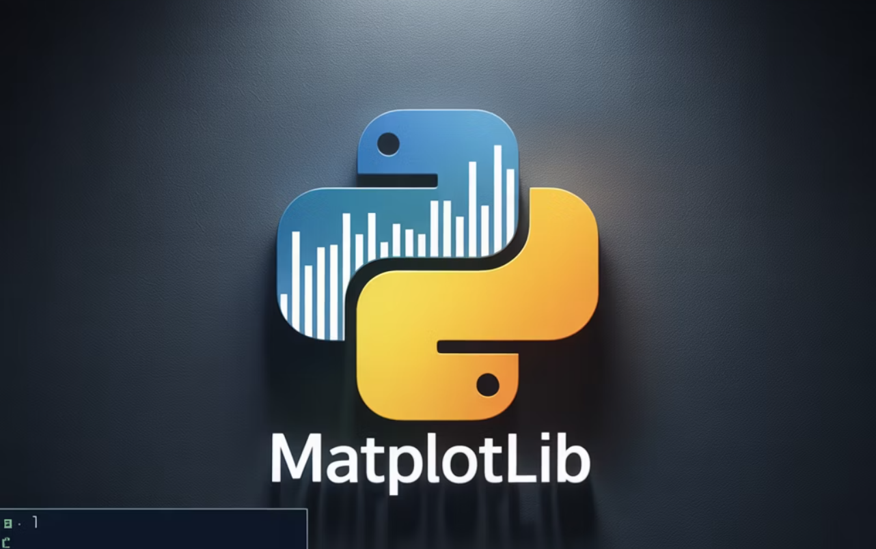
Introduction to Matplotlib
Core 2D Plotting Library for Static, Animated and Interactive Visuals
Comprehensive control
Customise every aspect of plots precisely
Versatile output
Create static images, animations and interactive visualisations
Notes:
Introduction to Matplotlib
Python's fundamental 2D plotting library providing low-level control over visualizations. Creates static, animated, and interactive plots while serving as the foundation for other visualization libraries.
Comprehensive Control
Fine-tune every aspect of your plots with precise customization options.
Versatile Output
Generate static images, animations, and interactive visualizations.
Image:
From the Slide deck Slide 59

Slide 89




Matplotlib
Key Functionalities
Line plots
Bar charts
Show trends over time and continuous relationships
Compare categorical data across groups
Histograms
Scatter plots
Display data distributions and value frequencies
Analyse relationships between two continuous variables
Notes:
Matplotlib Key Functionalities
Line Plots
Perfect for showing trends over time and continuous data relationships.
Bar Charts
Ideal for comparing categorical data and discrete values across groups.
Histograms
Reveal data distribution patterns and frequency of values in datasets.
Scatter Plots
Explore relationships and correlations between two continuous variables.
Customization Options: Labels, titles, legends, colors, and styles for professional presentations.
Image:
Infographic Repository Slide 81
Icon 1: https://www.shutterstock.com/image-vector/square-area-icon-coordinate-axes-sign- 2161023187
Icon 2: https://www.shutterstock.com/image-vector/black-single-arrow-growing-chart-graph- 2482543831
Icon 3: https://www.shutterstock.com/image-vector/chart-histogram-icon-vector-web-computer- 2628517927
Icon 4: https://www.shutterstock.com/image-vector/scatter-plot-vector-icon-illustration- 1025544037

Slide 90




Introduction to Seaborn
Built on Matplotlib
Beautiful defaults
Statistical focus
Pandas integration
Works seamlessly with DataFrames for streamlined visualisation
Leverages Matplotlib while offering a simpler, user-friendly API
Produces elegant visualisations with minimal code
Is optimised for statistical plots and data analysis workflows
Notes:
Introduction to Seaborn
Built on Matplotlib
Leverages Matplotlib's power while providing a more intuitive interface.
Beautiful Defaults
Stunning visualizations with minimal code and elegant styling out of the box.
Statistical Focus
Designed specifically for statistical visualizations and data analysis workflows.
Pandas Integration
Works seamlessly with DataFrames for streamlined data visualization.
Image:
Infographic Repository Slide 4 (Remove the arrows from it.)

Slide 91



Seaborn
Key Functionalities
Distribution plots
Use histograms and KDE plots to examine data distributions and density
Categorical plots
Visualise categorical data with bar charts, box plots and violin plots
Relational plots
Explore variable relationships using scatter and line plots
Advanced visualisations
Analyse correlations and multiple variables with heatmaps and pairplots
Notes:
Seaborn Key Functionalities
Distribution Plots
Histograms and KDE plots for understanding data distributions and density.
Categorical Plots
Bar charts, box plots, and violin plots for categorical data analysis.
Relational Plots
Scatter and line plots to explore relationships between variables.
Advanced Visualizations
Heatmaps and pairplots for correlation analysis and multi-variable exploration.
Image:
Infographic Repository Slide 31
Icon 1: https://www.shutterstock.com/image-vector/scatter-plot-line-icon-distributed-points- 2672234967
Icon 2: https://www.shutterstock.com/image-vector/bar-chart-graph-icon-sign-vector- 2651019237
Icon 3: https://www.shutterstock.com/image-vector/square-area-icon-coordinate-axes-sign- 2161023187
Icon 4: https://www.shutterstock.com/image-vector/report-icon-analytics-data-research-market- 1450660847

Slide 92
Matplotlib v. Seaborn
Matplotlib | Seaborn
Provides low-level, flexible control | Offers high-level, aesthetic interface
Offers detailed customisation | Focuses on statistical visualisations
Ideal for precise, custom visualisations | Ideal for quick EDA and clear insights
Notes:
Matplotlib vs Seaborn
Matplotlib
Low-level, flexible control
Detailed customisation options
Best for precise, custom visualisations
Seaborn
High-level, aesthetic interface
Statistical visualisation focus
Best for quick EDA and clear insights

Slide 93



Combining Seaborn and Matplotlib
Start with Seaborn: Generate quick, attractive plots for initial exploration
Enhance with Matplotlib: Apply precise customisations for publication-quality visuals
Achieve synergy: Combine both libraries for a complete visualisation toolkit
Notes:
Combining Both
Start with Seaborn
Create quick, beautiful plots for initial data exploration and statistical analysis.
Enhance with Matplotlib
Add fine-tuned customizations and precise control for publication-ready visualizations.
Perfect Synergy
Both libraries complement each other to create a complete visualization toolkit.
Image:
Infographic Repository Slide 141
Icon 1:https://www.shutterstock.com/image-vector/line-graph-icon-business-chart-symbol- 2642143935
Icon 2: https://www.shutterstock.com/image-vector/customisable-real-line-icon-data-chart- 1662029716
Icon 3: https://www.shutterstock.com/image-vector/integration-icon-on-white-background-automation- 1608388597

Slide 94





Best Practices for Data Visualisation
Choose right chart type: Match visualisations to data type and analytical goals
Avoid clutter: Remove unnecessary elements and prevent misleading scales
Keep it simple: Maintain clarity and avoid complexity
Add context: Include labels, legends and titles
Use colours wisely: Enhance readability and accessibility with thoughtful color choices
Notes:
Best Practices
Right Chart Type
Choose visualizations that match your data type and analytical goals.
Avoid Clutter
Prevent misleading scales and remove unnecessary visual elements.
Keep It Simple
Maintain clarity and avoid unnecessary complexity in your visualizations.
Add Context
Include labels, legends, and titles to make your plots self-explanatory.
Smart Color Use
Enhance readability and accessibility with thoughtful color choices.
Image:
Infographic Repository Slide 81
Icon 1:https://www.shutterstock.com/image-vector/dashboard-admin-line-icon-simple-outline- 1936662853
Icon 2:https://www.shutterstock.com/image-vector/data-sanitization-deleting-destroying-protection-icon- 2280802891
Icon 3:https://www.shutterstock.com/image-vector/small-data-icon-flat-design-business- 364287971
Icon 4: https://www.shutterstock.com/image-vector/ai-generated-icon-star-square-tools- 2488657531
Icon 5: https://www.shutterstock.com/image-vector/readability-check-vector-icon- 758794777

Slide 95
Summary
Offers flexible, low-level control for custom visualisations
Provides high-level interface with statistical focus and attractive defaults
Combine both for robust data exploration and storytelling
Matplotlib
Seaborn
Complete Toolkit
Notes:
Summary
Matplotlib
Base library offering powerful flexibility and precise control for custom visualizations.
Seaborn
High-level interface providing statistical focus with visually appealing default styles.
Complete Toolkit
Together, they form an essential foundation for data exploration and storytelling.
Image:
Infographic Repository Slide 58

Slide 96
Mastering Code Modularisation
(Topic 10 of 10)

Slide 97
Mastering Code Modularisation
“Where Can I Modularise My Work Using Functions/Libraries?”
Break large, repetitive code into smaller functions
Reuse existing code instead of rewriting it
Create libraries or modules for frequently repeated tasks
Improve readability, debugging and team collaboration
Notes:
Mastering Code Modularisation “Where can I modularize my work using functions/libraries?”
Break large, repetitive code into smaller functions
Reuse code instead of rewriting it
Create libraries/modules for tasks you do often
Improves readability, debugging, and collaboration
Image:
Infographic Repository Slide 91

Slide 98
Examples of Effective Modularisation
Functions
Write a single clean_data() function to handle all preprocessing consistently.
Libraries
Use established libraries like pandas to replace manual loops with optimised, tested code.
Custom modules
Bundle reusable functions into a module such as utils.py and import it across projects.
Notes:
Examples of Effective Modularization
Functions
Instead of repeating data cleaning steps throughout your code, write a single clean_data() function that handles all preprocessing consistently.
Libraries
Use established libraries like pandas for data handling instead of writing manual loops, leveraging tested code that's optimized for performance.
Custom Modules
Bundle your reusable functions (e.g., utils.py) and import them across multiple projects to maintain consistency and save development time.
Image:
Infographic Repository Slide 86

Slide 99

Examples of Effective Modularisation
Reflection Questions
Which parts of your recent project could be modularised into functions?
What repeated tasks could be converted into a reusable library?
Notes:
Reflection Questions
Which parts of your recent project could have been functions?
What tasks do you repeat often that could become a library?
Image:
https://image.shutterstock.com/image-photo/checking-financial-reports-graphs-charts-260nw-518338252.jpg
Infographic Repository Slide 44

Slide 100
Q & A

Slide 101
Thank you

